Slide 1
CLASS III QUIZ

Slide 2
Word Magic

Slide 3

HOMOPHONES

Slide 4
We sat in the ___
(rose/rows)

Slide 5
The pigeon is a symbol of ______
(piece/peace)

Slide 6
He went to Australia by sea ___________
( route/root)

Slide 7
I love to watch animated T.V ___________
( cereal/serial)

Slide 8
My mother brought candles from Diwali _________
(Fare /fair )

Slide 9
`
There are seven days in a ___________
( week / weak)

Slide 10
He asked for a pizza _______
byte/bite

Slide 11

Synonyms

Slide 12
Find out the odd one

Slide 13
Energy Power Strain

Slide 14
Goal Success
Target

Slide 15
Admire Praise
Achieve

Slide 16
Diligent Perfect
Hardworking

Slide 17
Spacious Freedom
Liberty

Slide 18
Enough Required
Sufficient

Slide 19
Astonish Hilarious
Surprise

Slide 20
ANTONYMS

Slide 21
Fresh bread

Slide 22
Clever Birds

Slide 23
Wide Road

Slide 24
Expensive Ring

Slide 25
Interesting Movie

Slide 26
Dangerous Path

Slide 27
Rough Surface

Slide 28
Boojho
Toh
Jaane

Slide 29


Slide 30
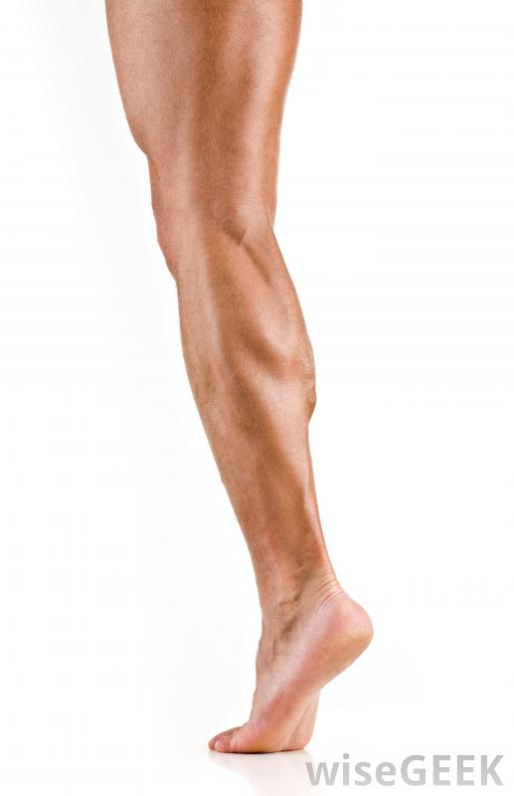

Slide 31
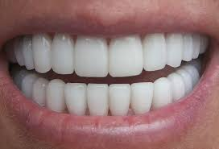

Slide 32
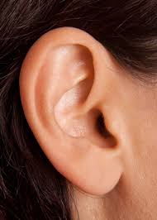

Slide 33
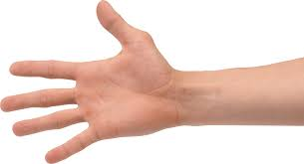

Slide 34
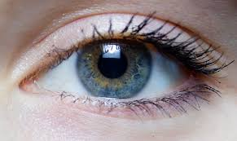

Slide 35
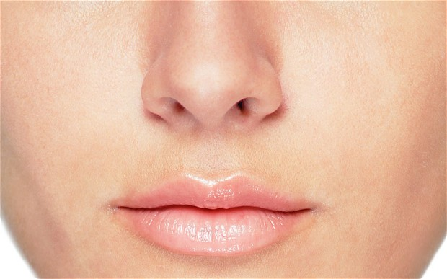

Slide 36
MATHEMATICS

Slide 37
KNOCK THE
MULTIPLES

Slide 38
25 35 46
59 20

Slide 39
18 36 24
15 54

Slide 40
33 40 27
84 12

Slide 41
42 54 40
49 22

Slide 42
27 21 49
36 45

Slide 43
24 15 9
29 27

Slide 44
26 38 28
35 63

Slide 45
PROUD
TO BE
AN INDIAN

Slide 46
Southern coastal state

Slide 47
Northern mountain state

Slide 48
A state that shares border
with Nepal.

Slide 49
A state that has west in its
name but it is in the east.

Slide 50
A state famous for Bollywood

Slide 51
Name the state whose capital
is Gandhinagar.

Slide 52
Name the state whose capital
is Bhubaneswar.

Slide 53
AMAZING ANIMALS

Slide 54
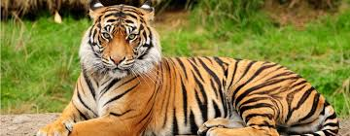

Slide 55
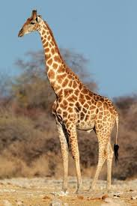

Slide 56
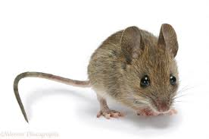

Slide 57
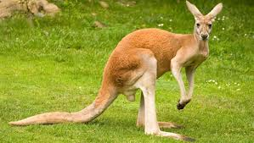

Slide 58
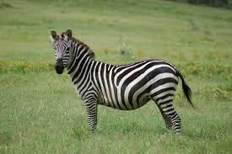

Slide 59
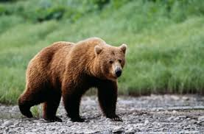

Slide 60
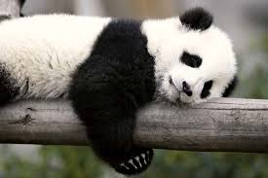

Slide 61
Fascinating Birds

Slide 62
It makes nest on the topmost
branch of the tree.

Slide 63
State bird of Delhi

Slide 64
It stitches leaves to make its
nest.

Slide 65
Flightless bird

Slide 66
Its a name of a bird as well as
of a fruit.

Slide 67
It makes nest in tree’ s trunk.

Slide 68
Its babies are called
peachicks.

Slide 69
SPORTS ICON

Slide 70
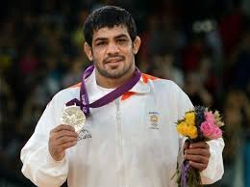

Slide 71
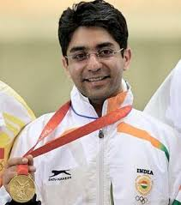

Slide 72
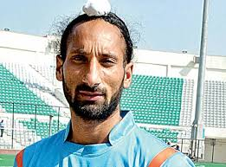

Slide 73
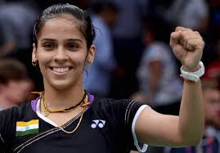

Slide 74
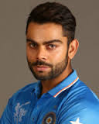

Slide 75
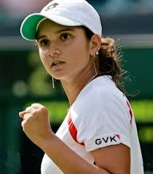

Slide 76
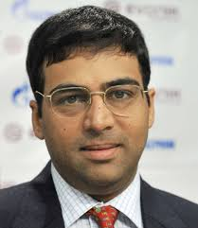

Slide 77
RAPID FIRE ROUND

Slide 78
Knowledge is
the best and the safest treasure to acquire.

Slide 79


